Slide 1
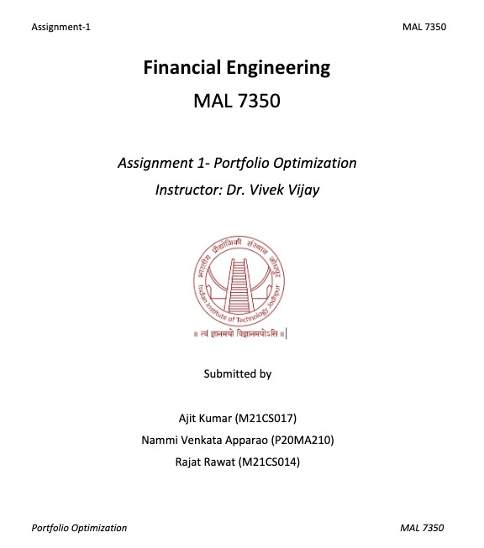

Slide 2
Contents
Introduction
Ten Risky asset with the return values.
Markowitz efficient frontier using mean-variance theory
Obtaining CAPM model & drawing line and tangent to the
efficient frontier
Obtaining SMLs using three risky assets

Slide 3
Introduction
Modern portfolio theory (MPT), or mean-variance analysis, is a mathematical framework for assembling a portfolio of assets such that the expected return is maximized for a given level of risk. It is a formalization and extension of diversification in investing, the idea that owning different kinds of financial assets is less risky than owning only one type. Its key insight is that an asset's risk and return should not be assessed by itself, but by how it contributes to a portfolio's overall risk and return. It uses the variance of asset prices as a proxy for risk.

Slide 4
Calculation Step
First we have taken 3 months(01-10-2020 to 31-12-2020) closing
price data of 10 risky assets from investing.com.
Next, we have calculated daily percentage returns for 10 assets.
Return=((Tomorrow price-Today price)/today price)*100
After that, we have calculated mean of each company's daily
percentage returns and it is named as m.
mean=(sum of returns)/Total number of days

Slide 5
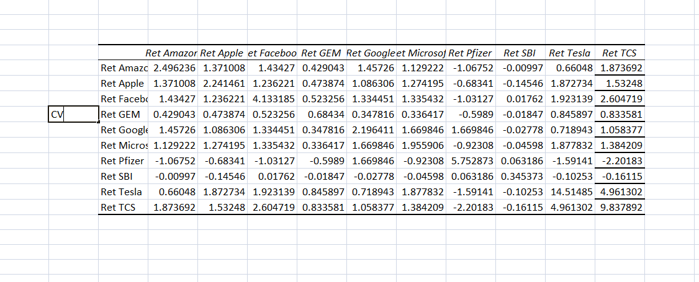
Next we have calculated covariance matrix as "CV“.
Covariance matrix

Slide 6
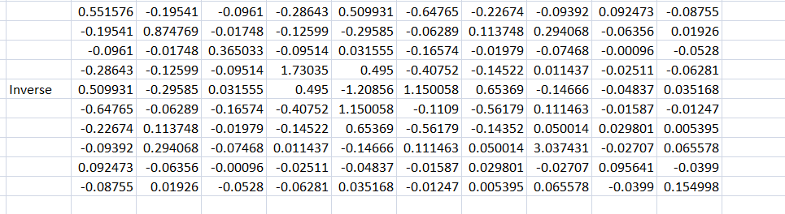
Then we calculated, inverse of CV and named as "CI".
Inverse Matrix

Slide 7
Covariance matrix and inverse of it calculated as follows:
Covariance=VARP(Sheet1!$K$2:$K$64)
Inverse=MINVERSE(CV)
Expected return (μ)=Σ(w_{i}*μ_{i})
w_{i}=weight,
μ_{i}=mean percentage return of i^{th} portfolio.

Slide 8
Variance (σ²)=var(Σ(w_{i}*R_{i}) )
w_{i}=weight
R_{i}=ith portfolio return.
Now our aim is to find out weight vector so that for a given expected
return μ the variance will be minimum i.e
min (σ²)
subject to:
(μ)=Σ(w_{i}*μ_{i})
Σ(w_{i})=1

Slide 9
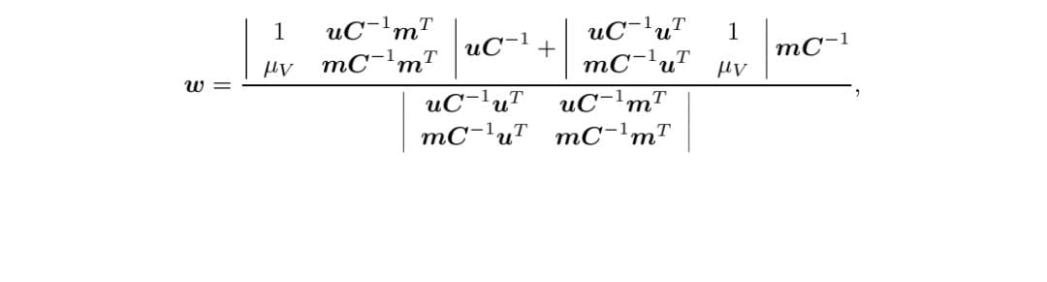
From Markowitz theory we have calculated W and the variance for
different value of μ by using the formula.

Slide 10
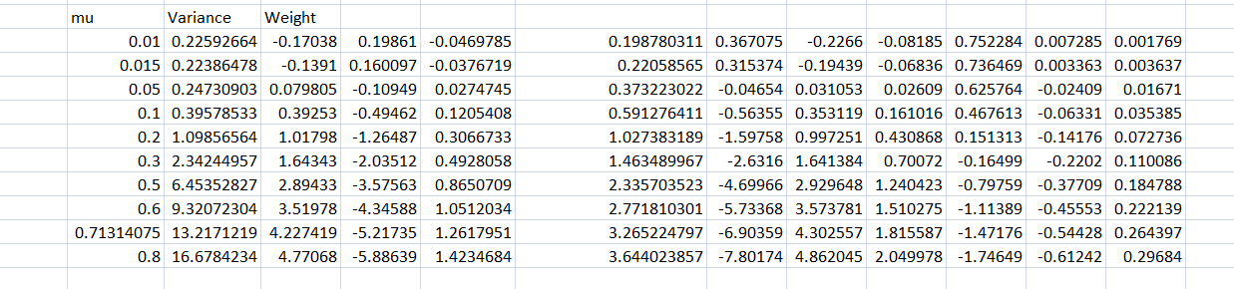

Slide 11
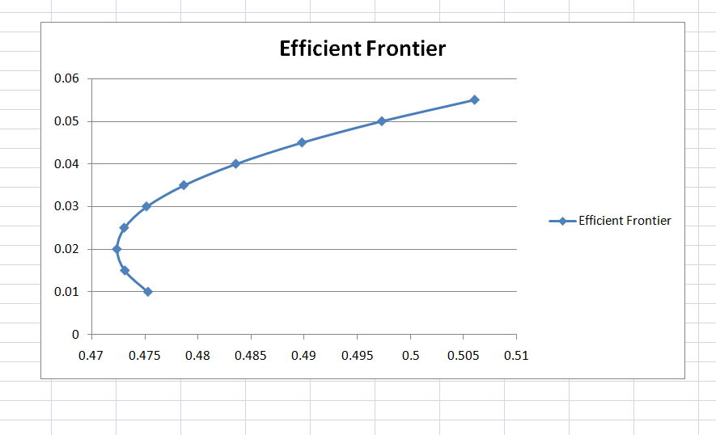
Now we have plotted a graph between σ (x-axis) and μ(y-axis)
then we get a Markowitz bullet as follows.

Slide 12
CAPM
In this model , we consider one risk free asset (HDFC FD) besides
those 10 risky assets.
Now here our aim is to finding weights for the given μ so that our
variance is minimum by CAPM model.
We have calculated W* and then variance for the given μ .

Slide 13
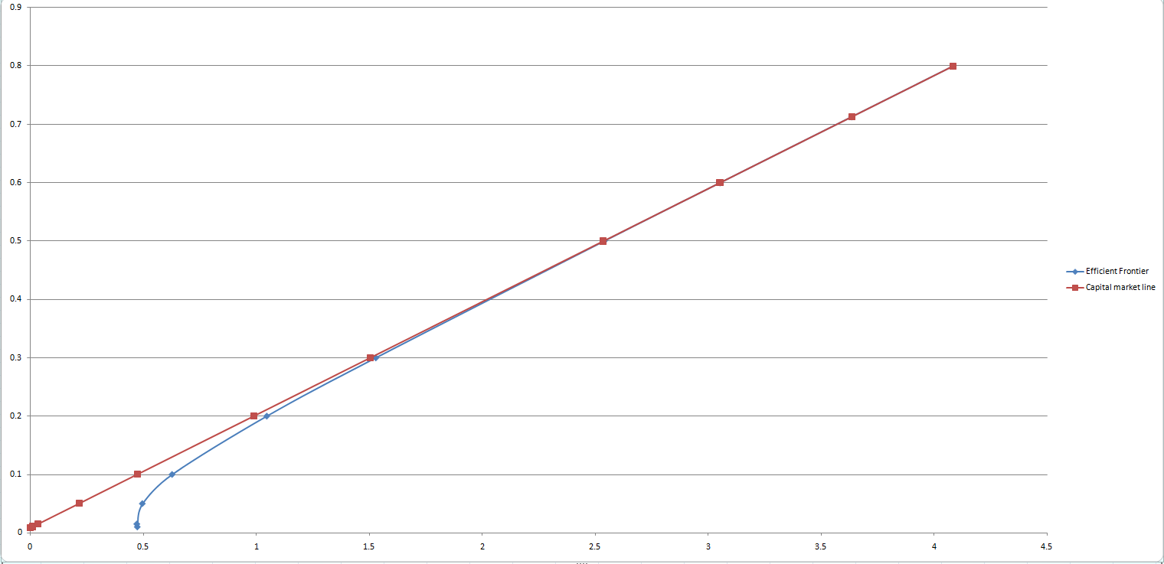
Plotting graph between μ and σ then it will be a tangent to the
Markowitz bullet as shown in figure.

Slide 14

Security market line(SML)
We consider , the asset SBI , let μ_{V} be the expected return of asset SBI
μ_{M} be the expected return of the market portfolio, then relation
between μ_{V} and μ_{M} is given by:
Where, β_{V} is given by:

Slide 15
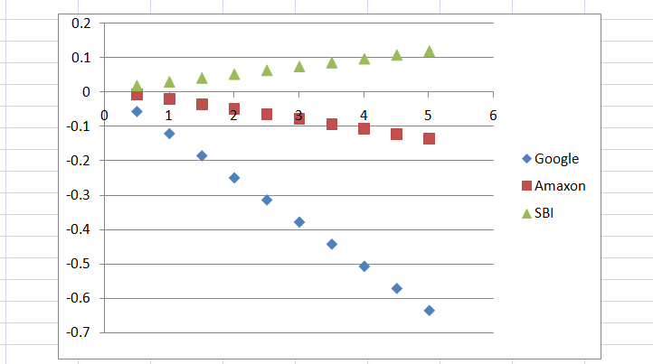
Then we get following line which is called security market line for SBI:
We also did the same for Amazon and Google.

Slide 16
References
Mathematics for finance ,an introduction of Financial Engineering
by: Marek Capinski and Tomasz Zastawniak
https://www.investing.com/

Slide 17
THANK YOU

